Slide 1
Causelists
Name Roll no.
Sritej Reddy 17ucs094
Shreyash gade 17uec117
Vishnu Reddy 17uec039

Slide 2
Overview
The Causelists are schedule of cases to be heard by the courts on the following day(s). Every court must have a causelist for each working day.
We downloaded these causelists from high court websites of each states .
We made several kind of analysis using this causelists data and inferenced the trends that are occurring.

Slide 3
Project Motive
Daily many people visit courts as their cases are scheduled but they end up going back without getting their case heard .
Due to this there is approximately 0.5% effect in GDP as the important time of people getting wasted in visiting courts and waiting for their case to be heard .
By analyzing the high court causelists data we are trying to solve the scheduling problem that many people are facing.

Slide 4
Extraction of Causelists data
Using Selenium Webdriver and BeautifulSoup package available in python,we have extracted the causelists data from the high court websites of each state.
Converted all the pdf files to csv files for further analysis of the data in python.

Slide 5

Screen Recording

Slide 6
Description Of DataSet
The dataset contains causelists data of jaipur High Court (2015-2019).
The dataset has 931532 rows and 8 columns.
DataFields-
CASE_TITLE - Title of case
CASE_NO - Number assigned for a case
CASE_TYPE - Type of the case
R-ADVOCATE - Name of the Respondent Advocate
P-ADVOCATE - Name of the Petitioner Advocate
COURTROOM - Number of the Courtroom
JUDGE - Name of the judge
DATE - Date of hearing

Slide 7
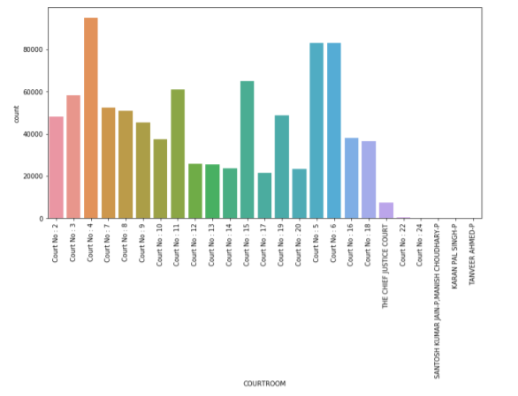
This plot represents the count of number of cases scheduled in each courtroom.

Slide 8
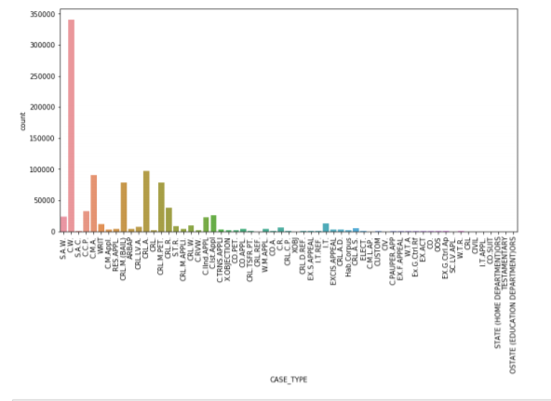
This plot represents the count of cases for each case type.

Slide 9
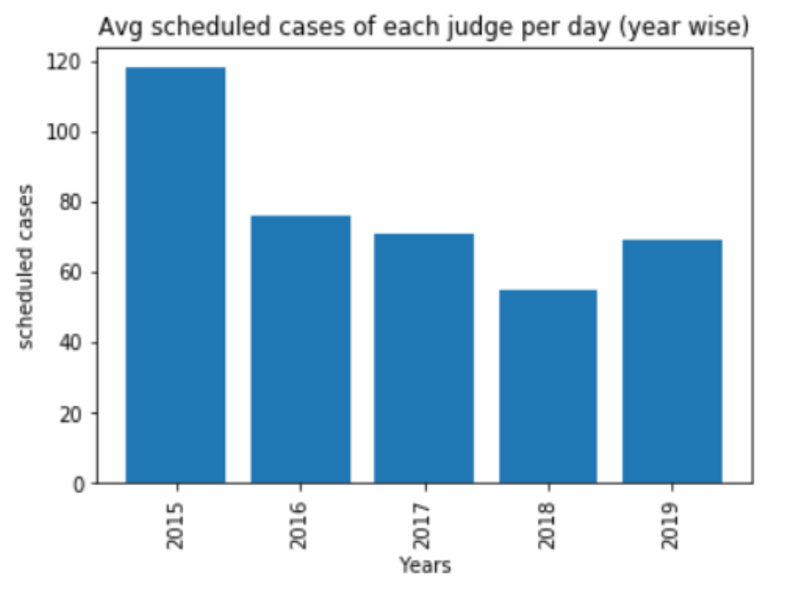
This plot represents the year wise average scheduled cases of judge per day.
From the plot we can infer that the average scheduled cases per day for a judge is high in 2015 and low in 2018.
According to the plot we can infer that number of cases scheduled for each judge in jaipur high court is approximately 77 per day.
Reference of this plot was taken from the DAKSH REPORT.

Slide 10
Comparison with Daksh Report
Data collection commenced in December 2014, and as of 1 April 2016 in Daksh Report.
As per the plot from Daksh report obtained average is 97 .
Since in 2015 the average cases Scheduled per judge per day were higher the average obtained in Daksh report is higher compared to average shown by plot (in above slide) .
But if we take Average of only 2015-16 data instead of 2015-19 we are able to obtain an average of around 97 which is very accurate to Daksh report value.

Slide 11
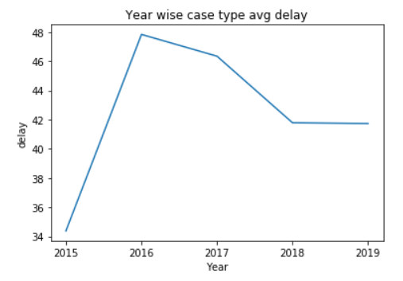
This plot represents the year wise trend of average delay of all case types

Slide 12
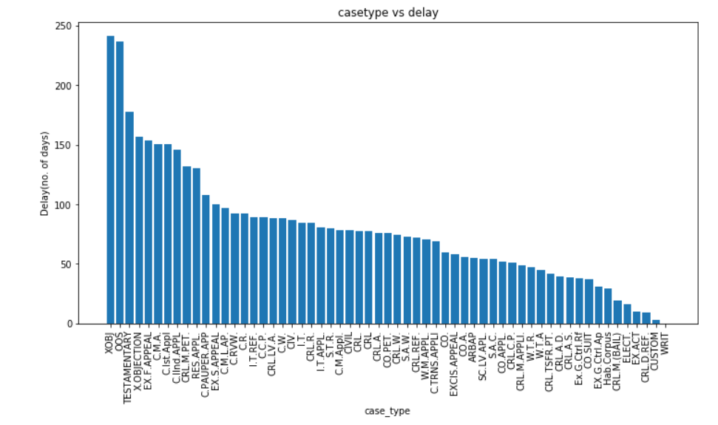
By concatenating Case_Type and Case_no we get a unique case .
We sorted the dates after grouping the data by above concatenation . Then took average of their differences to obtain average delay .
This plot basically represents delay in number of days for each case type.
From the plot we can infer that, X-OBJECTION(XOBJ) has highest delay and WRIT has least delay.

Slide 13
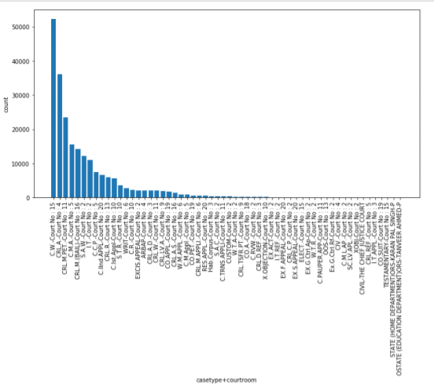
By concatenating Case_Type and CourtRoom, We wanted to find out in which courtroom a particular case type is most scheduled.
From this plot we can infer that CIVIL WRIT (CW)case type is most scheduled in CourtRoom-15.

Slide 14
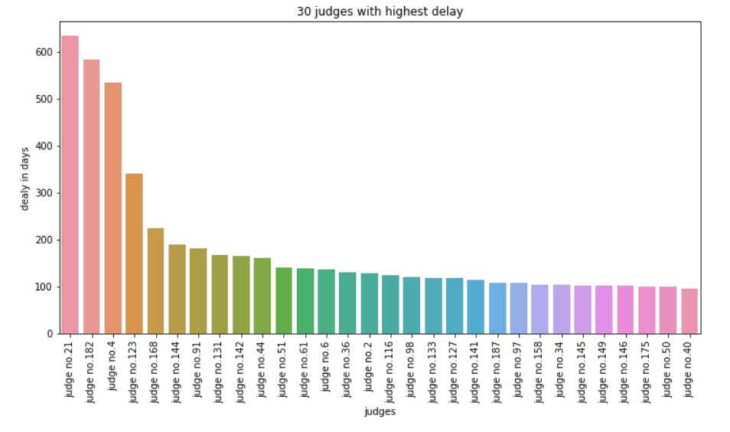
For each Judge we calculated the Average delay of the case in number of days .
This plot shows 30 judges with highest delays .
Judge no.21 has highest delay of 640 days .

Slide 15
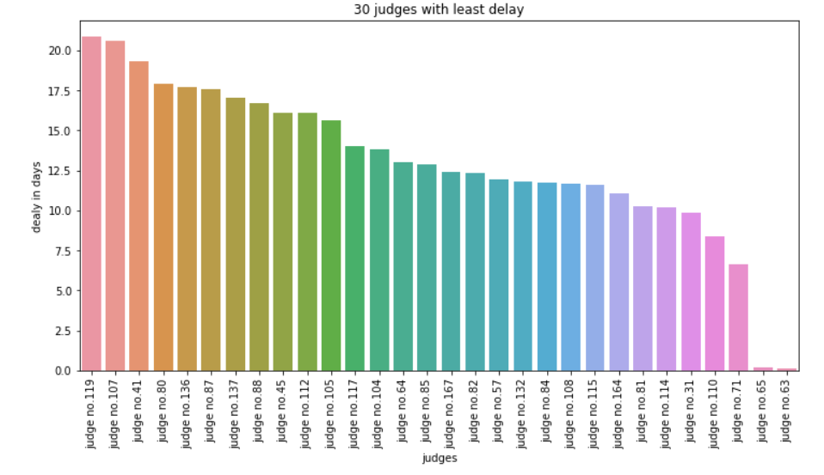
This plot shows 30 judges with least delay.
Judge no.119 has delay of 22 days and the remaining judges shown in plot has even lesser delay.

Slide 16
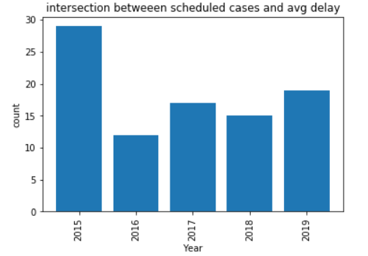
This plot shows the year-wise trend of intersection between the 30 judges with most scheduled cases and 30 with highest average delay.

Slide 17
Conclusion
From this project we learnt how to crawl the websites and automate the chrome driver to download the data and Performing various analysis techniques using python to find out the trends .
According to the analysis done on the Causelists data of scheduled cases , we encountered that how the scheduled cases are getting delayed and avg number of scheduled cases for each judge.
We could have come up with a suitable solution for scheduling cases if we had the hearing data .

Slide 18
Thank You

